Slide 1
Bore well Baby Rescue Machine
Ilayaraja R
Santhosh Kumar S
Srinivasan R
Pavithran V
Review - 1
Under the guidance of
Mrs.R.Devi M.Tech.,
Assistant Professor of IT.

Slide 2
Accidents in India in the past 4 years
S.No | Name of child | Age | Place | Alive/Dead | Source of info | Year
1 | R Madhumitha | 3 | TN | Died | Times of India | 2014
2 | Radheshyam | 2.5 | Jaipur | Died | Times of India | 2014
3 | Chinnari | 3 | Telangana | Died | Times of India | 2015
4 | K Tamilarasan | 2.5 | TN | Died | Times of India | 2015
5 | Komal | 6 | Rajasthan | Died | Deccan Chronicle | 2016
6 | Montu | 2 | Rajasthan | Died | NDTV | 2016
7 | Kaveri | 6 | Karnataka | Alive | firstpost.com | 2017
8 | Radha Sahu | 3 | Odissa | Alive | Hindustan times | 2017

Slide 3
Key Components
Light Camera
Personal Computer
PIC 16F877A Micro controller
12 V Power supply
Servo Motor
Oxygen Supply
Mechanical Arms

Slide 4
Flow Chart
Find the Child’s Position using Camera
Insert the mechanical arms inside the bore well
Start
Lift the baby using controller
Stop
Control the servo motors using micro controller
Provide Oxygen supply for the baby through thin pipe
Adjust the position of the baby using motor

Slide 5
Literature Survey
Existing System : Manual lifting of child.
Concept : The arms to lift child are manual and using pulleys the arms are moved accordingly to uplift the child.
Advantages :
No much expense.
Easy to develop the equipment.
Drawbacks :
Hard to grip the child.
Difficult to lift the child as all works are done manually by the rescuers.
Reference – Fire station, State bank Road, Coimbatore – 641018.

Slide 6
Literature Survey
Paper : Rescue System for bore well accidents (Sanket,Suraj,Pooja - Dr.D Y Patil School of Engineering, Pune)
Concept : Using AVR Atmel 16 controller the Arms of the mechanical system is controlled and the child is rescued.
Advantages :
Least time consumption.
Light weight but sufficiently strong.
Drawbacks :
AVRs have fairly low power. Availability is less. Speed is near 20MIPS instructions and runs at 80 MHz and can burst to 160 MHz.

Slide 7
Literature Survey
Paper : PC based Child Rescue system from Bore well (Banu, Amar, Benson -Bangalore Technological institute)
Concept : Using PIC controller and DC motor the Arms of the mechanical system is controlled and the child is rescued.
Advantages :
Cheap and small in size.
Can be easily embedded to any device.
Programming is simple to learn.
Drawbacks :
DC motors can be used only when there is a need for high RPM (Rotation Per Minute).
They are applicable for Car wheels, fans etc., and not applicable in this case.

Slide 8
Literature Survey
Paper : Rescue Robotics in Bore well Environment (Manish, P.Chakraborty and G.C.Nandi IIIT, Allahabad)
Concept : An elastic belt is provided along the machine to lift the child easily by holding the child from the bottom.
Advantages :
The child can be saved very fastly.
The child gets bottom grip and never falls in between.
Drawbacks :
The belt cannot be inserted easily due to small space inside bore well.
The child cannot fit into the belt even if the belt is reached inside.

Slide 9
Proposed System
The proposed system has 3 modules,
Design phase
Interfacing phase
Implementation phase

Slide 10
Design Phase
The drawbacks found from the literature survey are applied to our proposed system in design phase.
Microcontroller and Motor used in earlier systems are replaced.

Slide 11
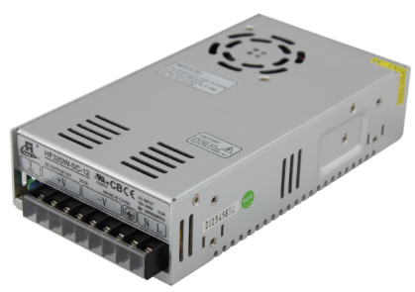
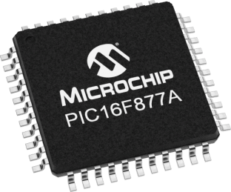

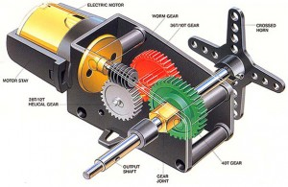
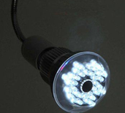
Design

Slide 12
PIC 16F877A Micro controller - Advantages
Malfunctioning of PIC percentage is very less.
Performance of PIC is very fast.
Power Consumption is very less.
From the programmer’s point of view, interfacing is very easy, also we can connect analog devices directly without any extra circuitry.
Programming is also very easy while compared to other microcontrollers.
Reference : https://www.electronicshub.org

Slide 13
Servo Motors - Advantages
Accurate rotation in a limited angle.
High-Performance than other motors(DC,Stepper)
If a heavy load is placed on the motor, the driver will increase the current to the motor coil as it attempts to rotate the motor.
Lower motor heating.
Better choice for variable load system.
Reference –
www.elprocus.com,
www.automationforum.in.

Slide 14
Interfacing phase
In this phase the micro controller will be interfaced with Servo Motor.
The command given by the controller should be functioned by the mechanical arms using the servo motors.
The interfacing software NI MAX will be used for controlling the peripheral devices through Micro controller.
NI MAX stands for National Instruments - Measurnment & Automation Explorer.
In NI MAX, the devices and interfaces and Lab View Softwares will be available.

Slide 15
Implementation phase
The last phase of implementation deals with simulation of the rescue operation.
Both the earlier 2 modules will be implemented and connected with the equipment.
A model is dropped inside a narrow deep pipe and rescue operation will be performed.

Slide 16
THANK YOU

